Slide 1


MoodMirror
Understanding Emotions Through NLP
A Step Toward Student Mental Well Being
Natural Language Processing
Dr. Pramod Gupta
Presented By:
Manu Mathew Jiss | | Darshana Prafulla Patil
Date:
4 Dec 2025

Slide 2
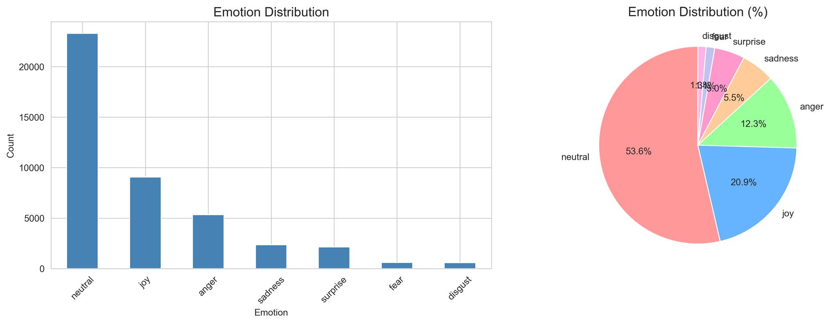
02 | Why MoodMirror? The Problem & Motivation
Problem Definition:
Classify emotional tone in short, informal comments written by Reddit users.
Use case: sentiment analysis, mental-wellness applications, and emotion-aware systems.
GoEmotions Dataset:
  Total samples: 54,263
    Train: 43,410
    Validation: 5,426
    Test: 5,427
  Content characteristics:
    Avg length: ~68 characters
    Avg tokens: ~12.8 words
  Original labeling: Multi-label, 27 emotions
  Our reduction: Converted to a single-label 7-class dataset
  Dataset challenge: Severe imbalance (~40:1 between largest & smallest classes)

Slide 3
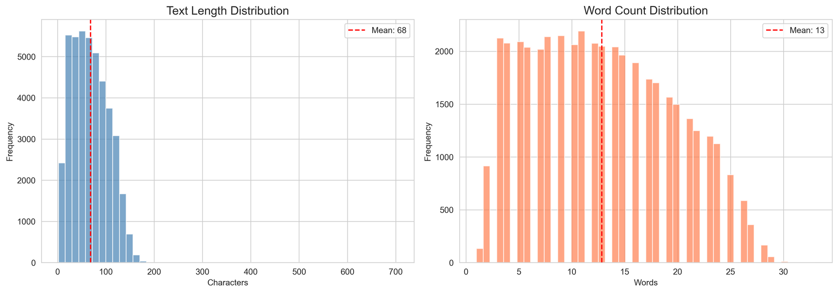
03 | Preparing the Data — Cleaning the Raw Emotion World
Preprocessing Steps:
  Text Normalization
    Lowercasing
    Remove URLs and HTML tags
  Reddit-Specific Cleaning
    Remove patterns like [NAME], r/subreddit, emails, and @mentions
    Strip hashtags but keep the word
  Emoji & Character Cleanup
    Remove all emojis, skin-tone modifiers, and special Unicode characters
    Keep meaningful punctuation
  Punctuation Handling
    Reduce repeated punctuation (!!! → !, --- → -)
    Preserve emotion-related symbols (!, ?, quotes, parentheses, etc.)
  Final Cleaning & Filtering
    Normalize extra spaces
    Remove extremely short texts (<3 characters)
    Removed 56 samples total
Outcome:
  Final dataset: 54,207 samples
  Clean, consistent text suitable for transformer tokenization
  Avg length: [Insert: 66 chars, 12.6 words]

Slide 4
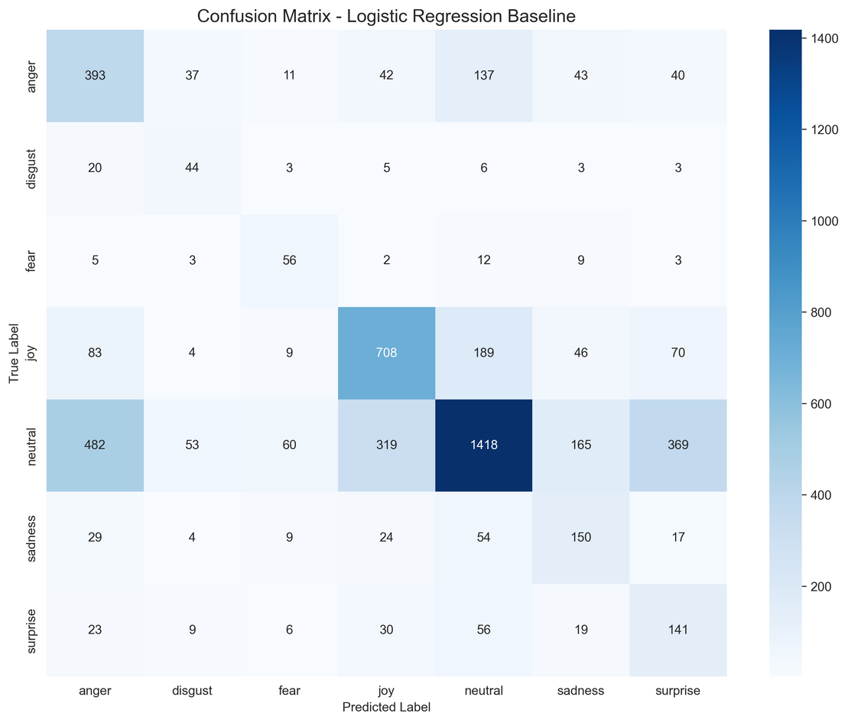
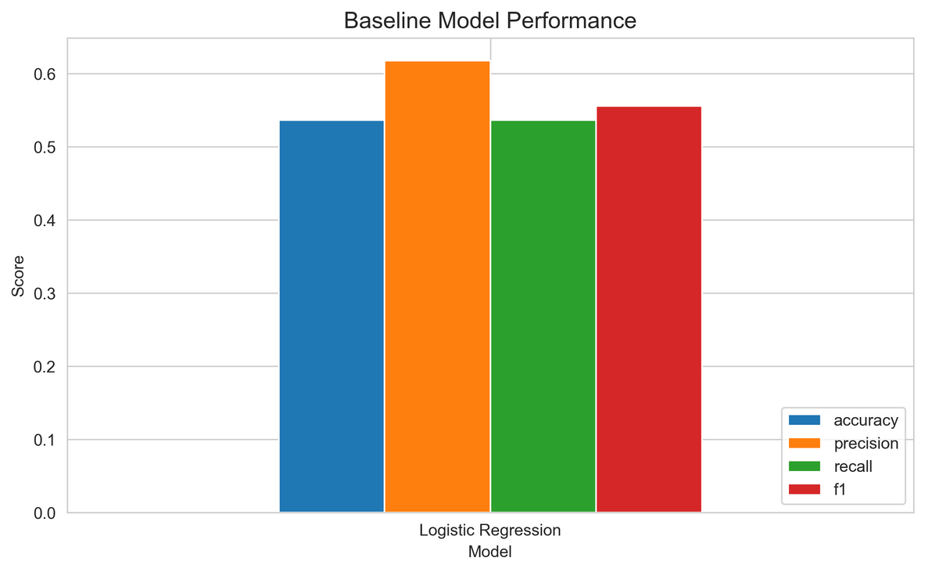
04 | Starting Small — The Baseline Model
Setup:
  Vectorization: TF-IDF (unigrams + bigrams)
  Balanced dataset: Oversampling & undersampling → ~6,194 samples/class
  Total balanced training samples: 43,358
Results (7-class):
  Accuracy: 53.66%
  Precision: 61.79%
  Recall: 53.66%
  F1-score: 55.56%
Interpretation:
The model struggled with overlapping emotional categories; lexical features were insufficient.

Slide 5
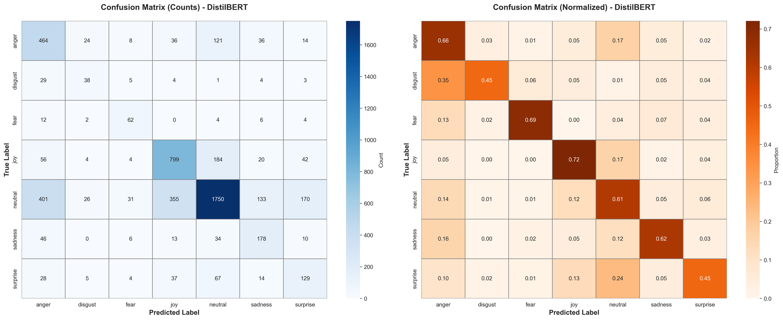
05 | Enter Transformers — DistilBERT
Model Details:
  Base: distilbert-base-uncased
  Parameters: ~66M
  Tokenizer: WordPiece, max length 512
  Training: ~3 epochs, balanced dataset, AdamW optimizer
Results:
  Accuracy: 63.06%
  Precision: 67.42%
  Recall: 63.06%
  F1-score: 64.06%
Improvement:
  +9.4 percentage points over the baseline
  Captures semantic & contextual cues better than TF-IDF

Slide 6
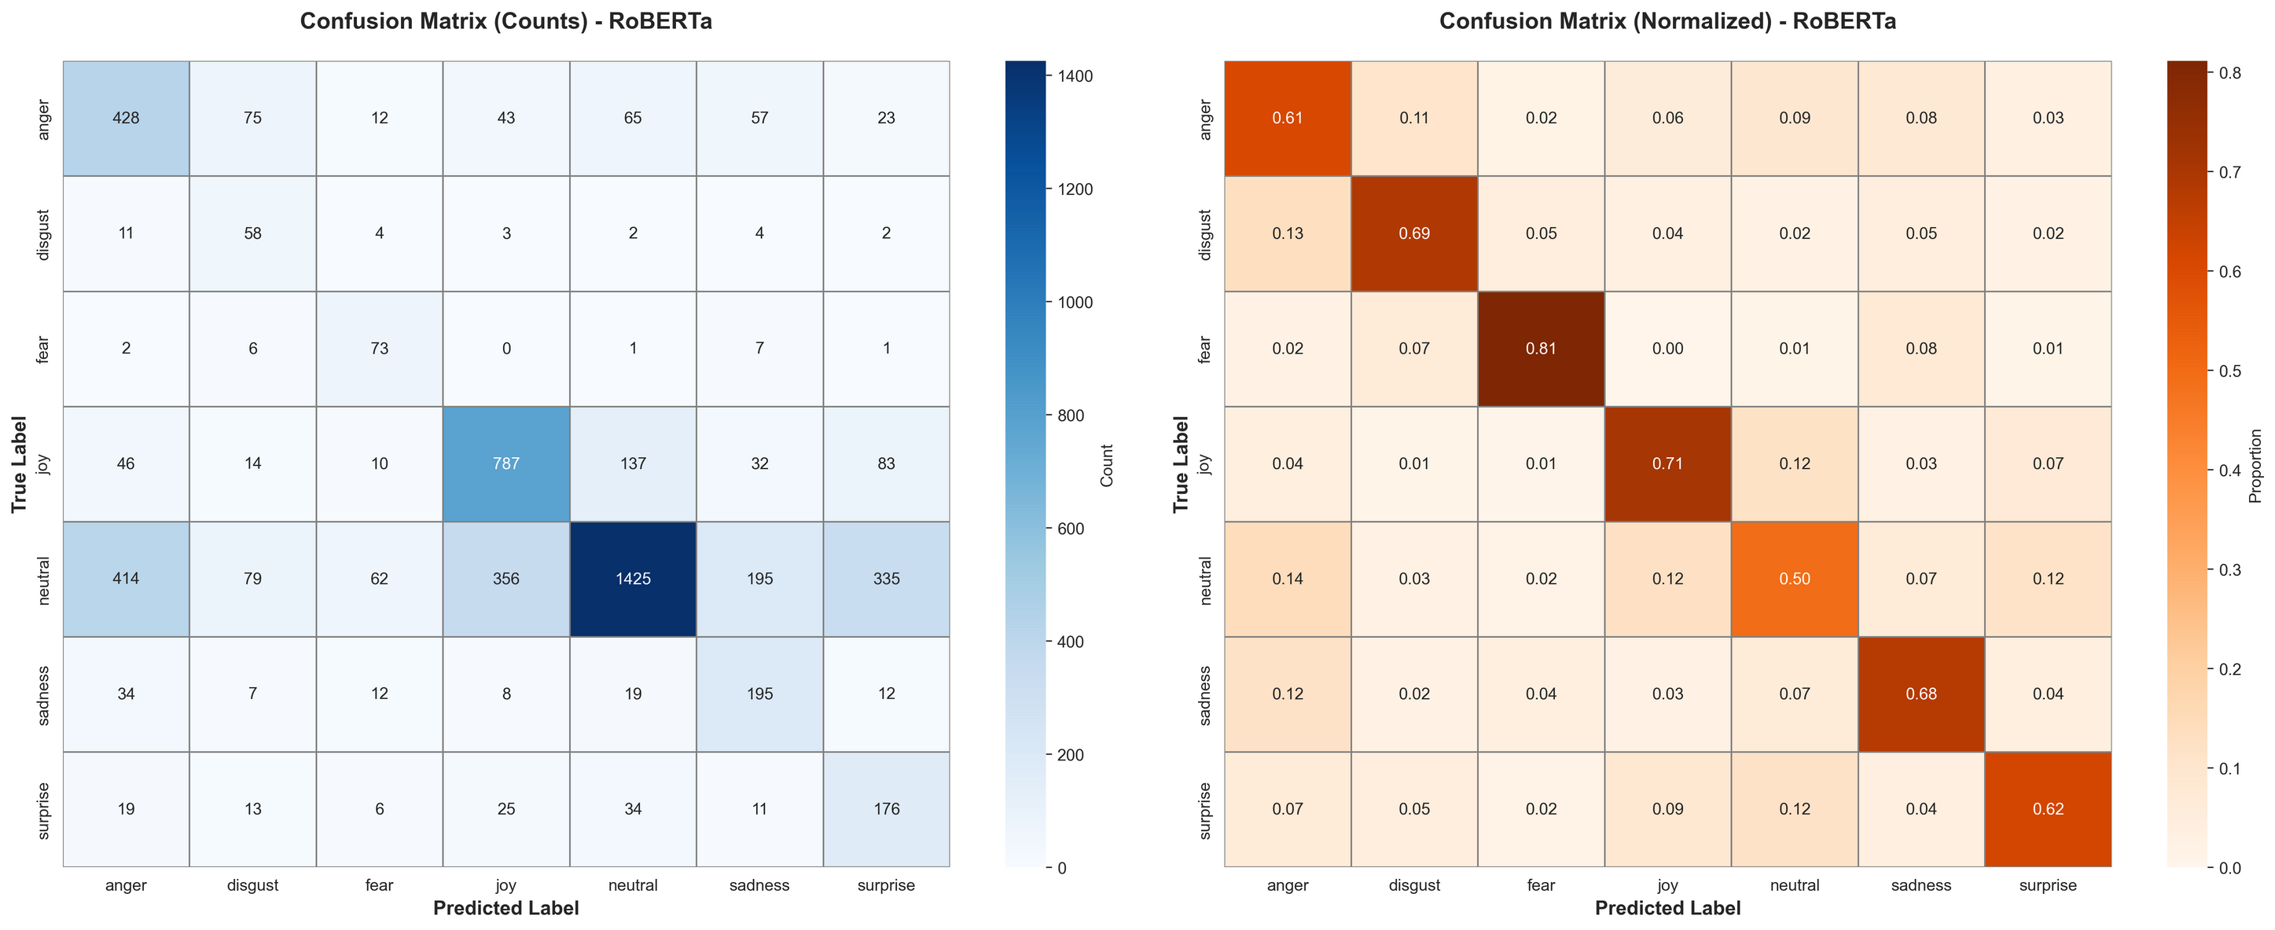
06 | RoBERTa — Stronger, but Still Challenged by 7 Classes
Model Details:
  Base: roberta-base
  Parameters: ~125M
  Strengths: Dynamic masking, large training corpus, strong contextual encoding
Results:
  Accuracy: 57.94%
  Precision: 68.29%
  Recall: 57.94%
  F1-score: 59.68%
Interpretation:
  Higher precision → confident when predicting
  Lower recall → struggles to generalize across 7 granular classes
  Indicates label complexity is a bigger issue than model architecture

Slide 7
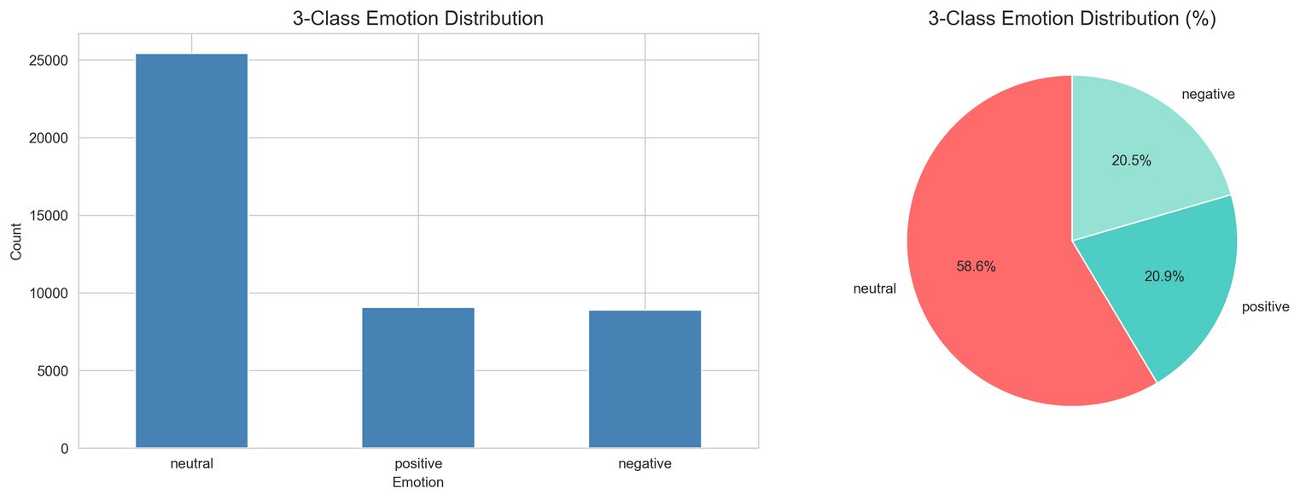
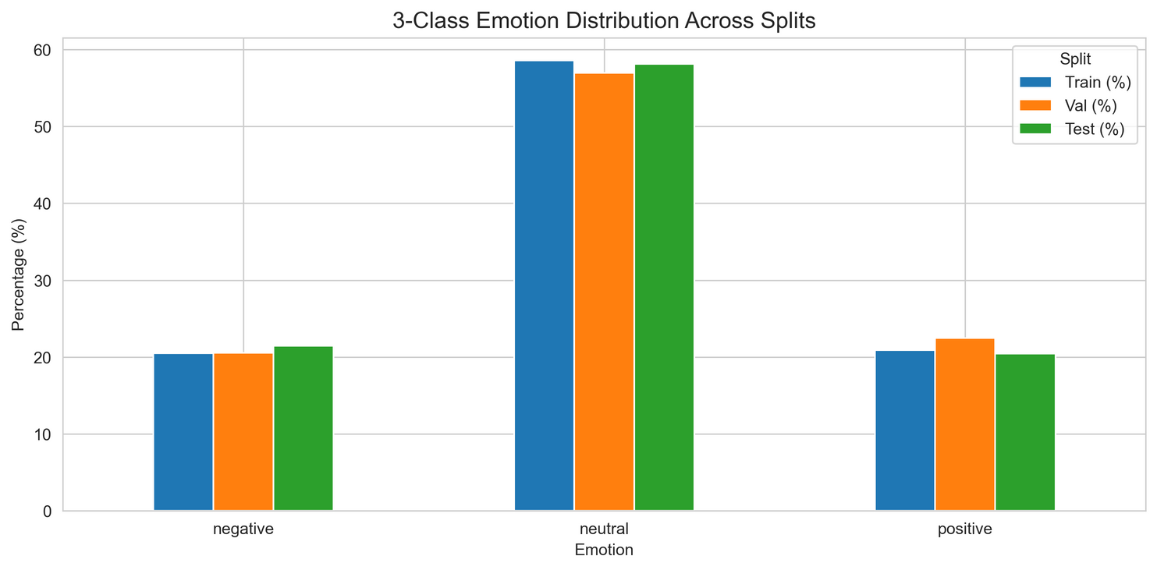
07 | The Pivot — Reducing to 3 Core Emotions
Motivation:
7-class system was too fine-grained: emotional boundaries overlapped heavily.
New Class Mapping:
  Positive: Joy, Surprise
  Negative: Anger, Disgust, Fear, Sadness
  Neutral: Neutral
Processing:
  Re-labeled entire dataset
  Preserved all preprocessing steps
  Rebalanced dataset across 3 classes

Slide 8
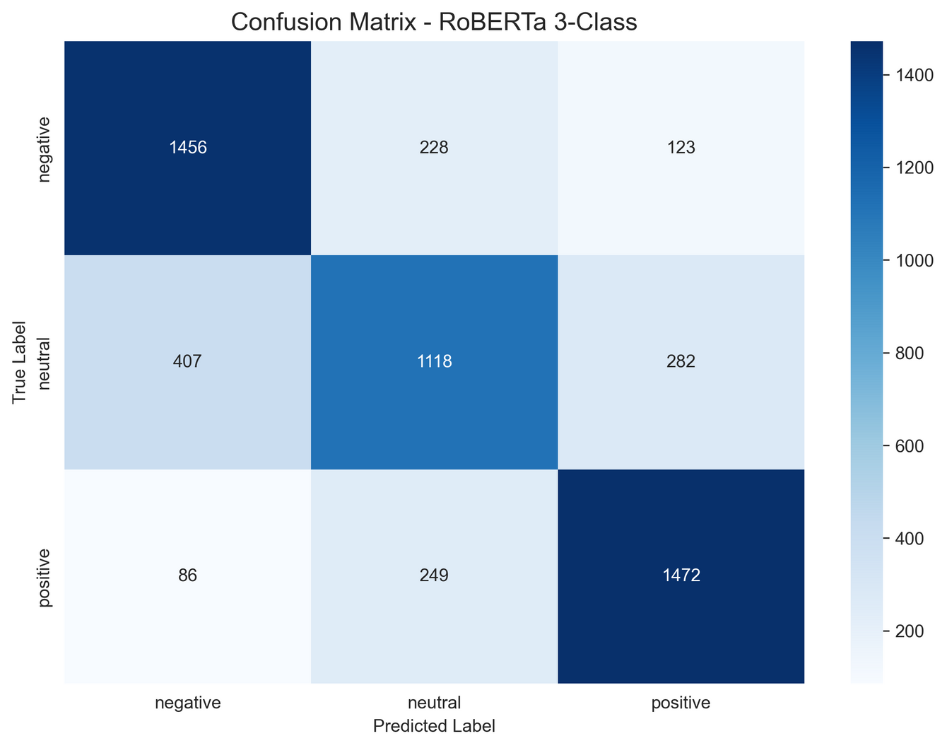
08 | RoBERTa (3-Class) — The Breakthrough
Performance:
  Accuracy: 74.64%
  Precision: 74.41%
  Recall: 74.64%
  F1-score: 74.39%
Why RoBERTa for the 3-Class Model?
  RoBERTa performs better than DistilBERT on coarse-grained emotion tasks (Positive/Negative/Neutral).
  Its stronger contextual encoding captures subtle cues in short Reddit-style text more effectively.
  With fewer classes, RoBERTa’s larger architecture becomes an advantage, improving overall accuracy and stability.
Key Improvements:
  +16.7% accuracy vs. RoBERTa-7-class
  Balanced across all metrics
  Robust, stable predictions suitable for deployment

Slide 9
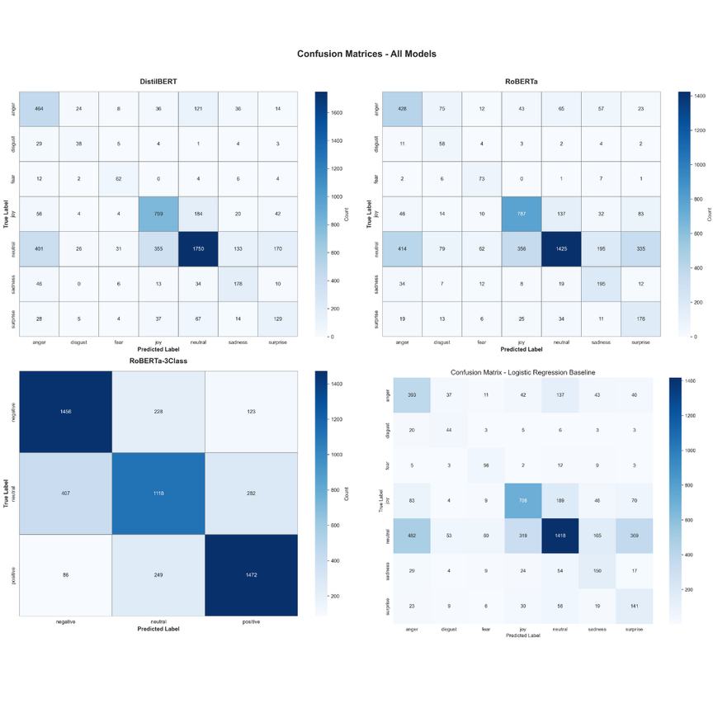
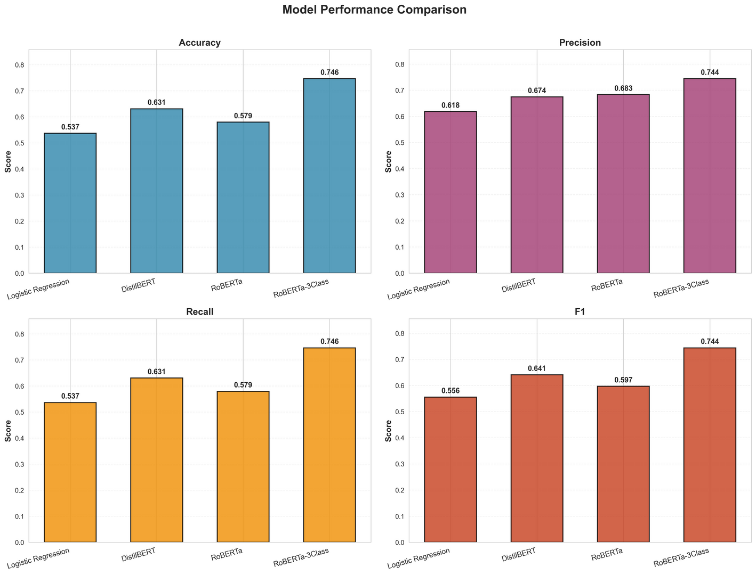
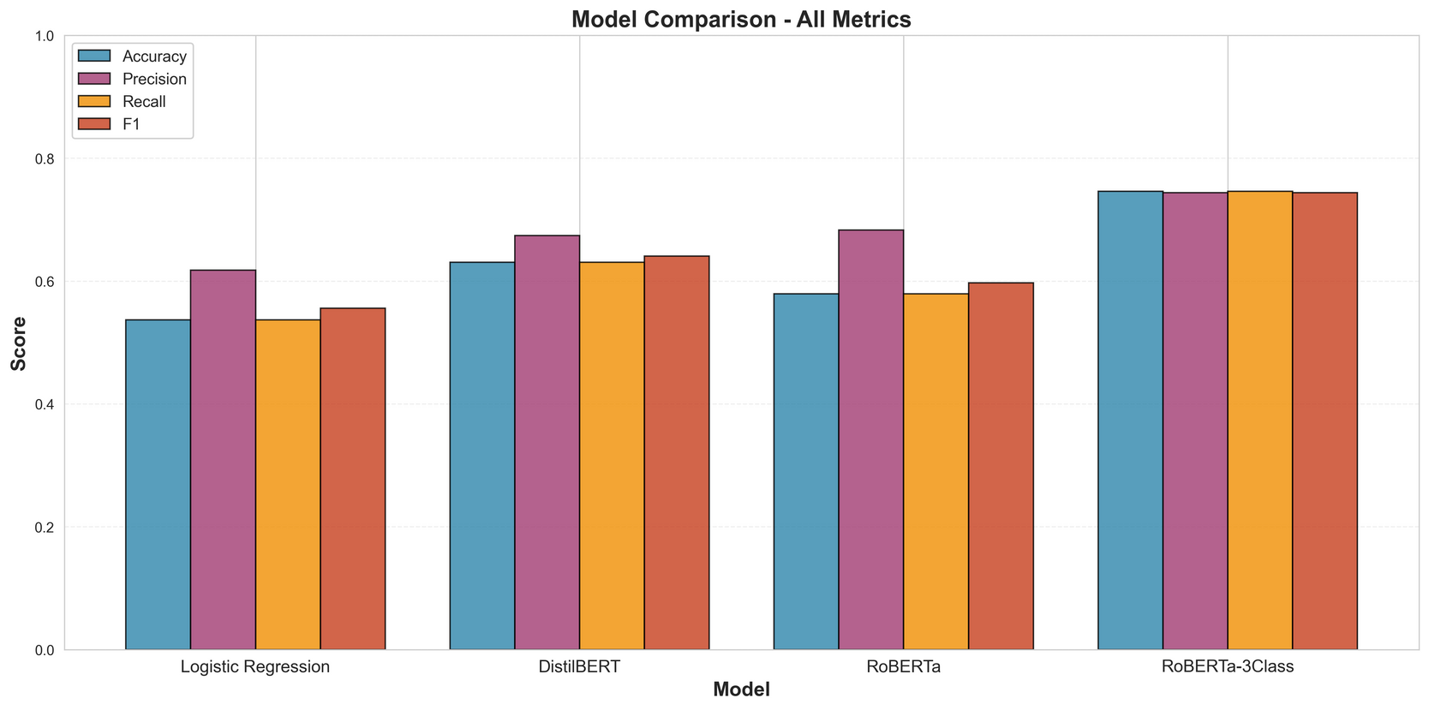
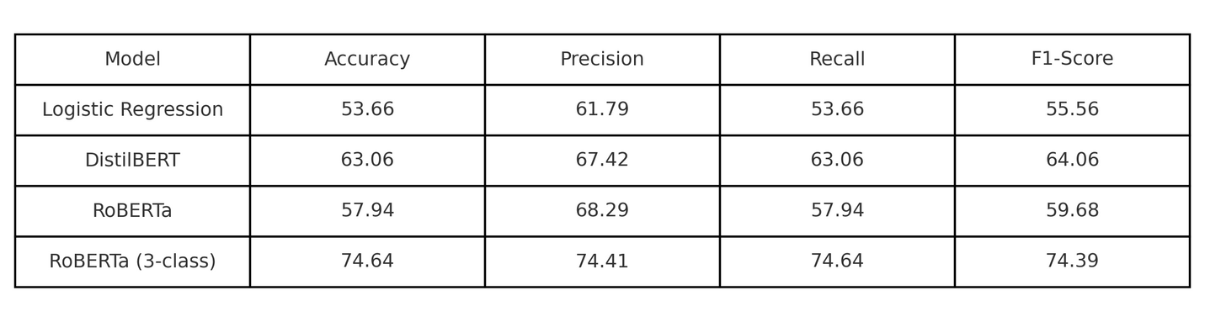
09 | Comparing the Journey — All Models at a Glance

Slide 10
09 | MoodMirror UI — Bringing the Model to Life
Tech Stack:
  Backend: RoBERTa 3-class model (PyTorch)
  Frontend: Streamlit
  Deployment: Localhost interactive demo (emotion_app.py)
UI Features:
  Real-time text-based emotion detection
  Batch input support (up to 4 sentences)
  Confidence scores displayed for each prediction
  Color-coded output (Positive / Negative / Neutral)
  Interactive emotion distribution visualization
LIVE DEMO!

Slide 11
10 | Project Summary — What We Achieved
What We Learned
  Worked with GoEmotions (54K samples)
  Reduced classes (27 → 7 → 3) for better performance
  Built strong preprocessing pipeline (text cleaning, emoji removal, Reddit patterns)
  Handled severe imbalance (40:1) using oversampling + undersampling
  Developed baseline (Logistic Regression) and transformer models
  Compared DistilBERT vs. RoBERTa across metrics
  Built a working Streamlit demo (MoodMirror UI)
Key Results
  Logistic Regression (7-class): 53.66%
  DistilBERT (7-class): 63.06%
  RoBERTa (7-class): 57.94%
  RoBERTa (3-class): 74.64% → Final Model
Main Insights
  Transformers outperform classical ML
  Fewer classes = higher accuracy and more stable predictions
  Preprocessing quality greatly impacts transformer performance
Future Work
  Upgrade models (RoBERTa-large, ensembles)
  Multi-language support & context-aware emotion detection
  Full app for students: mood tracking, trends, analytics
  Cloud deployment → Mobile app → Browser extension
Impact
Foundation for a complete emotion-aware student well-being application.

